Slide 1



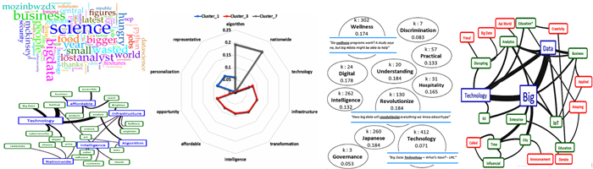
Introduction to Social Media Analytics (SMA) in Python Taufik Sutanto

Slide 2
Outline
Installation & registration of API (Python & its modules)
Introduction to SMA: Challenges, Methods, and Tools.
Crawling: Streaming, Searching, and Exporting Social Media data.
Network Analysis:
Centrality Analysis: Introduction, Methods, Applications in Python.
Community Detection: Introduction, Methods, Applications in Python.
Cluster Labelling: Using Topic Modelling.
Discussions

Slide 3
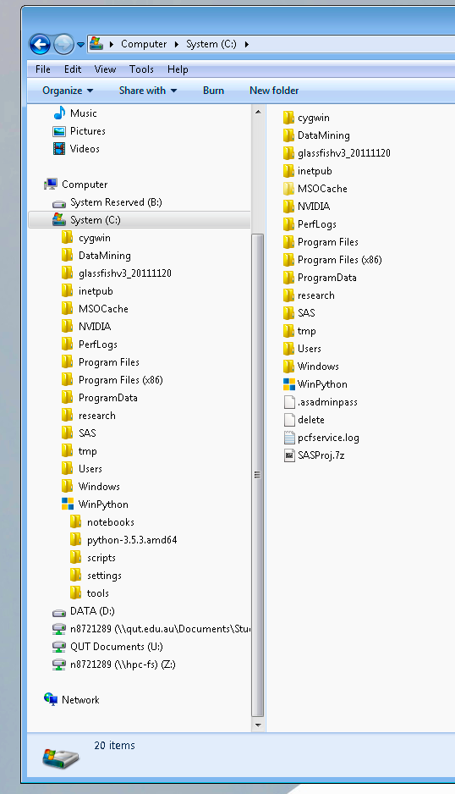
Requirements
Modules: Twython, NetworkX, json, community, tqdm, Wordcloud, scipy, numpy, NLTK.
Note: Install the community module from the source (don’t use pip/easyinstall/conda).

Slide 4
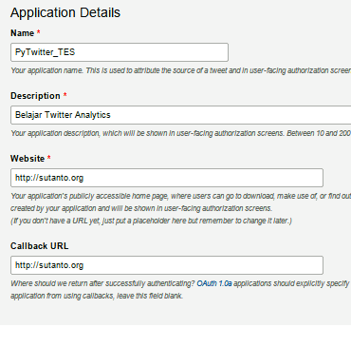

Registering Twitter App (Preferably done before the lecture)
Login to twitter : https://twitter.com/
Register your phone number: https://twitter.com/settings/add_phone
Go to : https://apps.twitter.com/
Go To Tab : “Keys & Access Tokens”
Click “Create My Access Token”
Copy the followings keys: consumer_key, consumer_secret, access_token, access_secret to any text editor (e.g. notepad) or preferably to: C:\WinPython\notebooks\MyApiKeys.txt
Any unique name
Any string
Any valid URL with http://
Any valid URL with http://
WARNING: Keep your keys private, you are responsible for your own keys.

Slide 5
How to use this PowerPoint slides (notes)
Be careful when doing copy-paste of commands between PowerPoint➔ Python console.
Symbols like apostrophe ‘ or quotation mark “ are not properly copied to the python console.
Please do make corrections on the Python console when needed.
You can simply follow this note by using commands that are printed using blue fonts.
Copy these commands sequentially to the Python console.
Each command is executed in the python console by simply pressing the Enter key.
Be mindful that all commands are case sensitive.

Slide 6

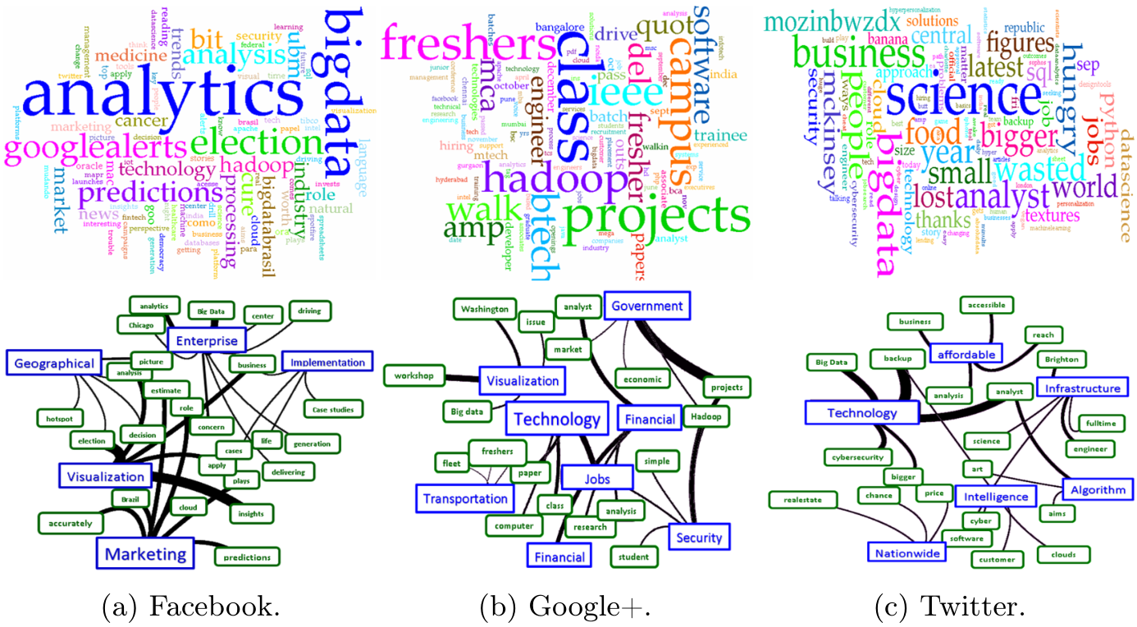
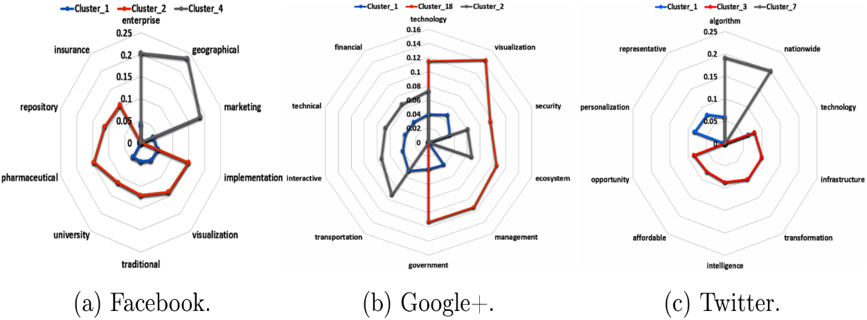
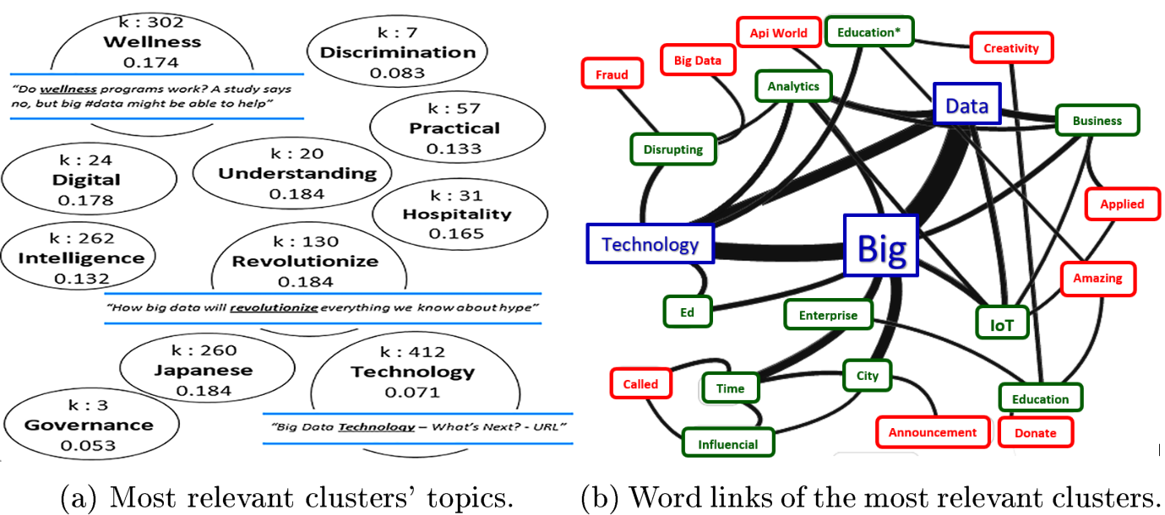
Social Media Analytics (SMA)
SMA is the process of gathering data from stakeholder conversations on digital media and processing it into structured insights leading to more information-driven business decisions and increased customer centrality for brands and businesses [1].
[1]. IT Glossary, Gartner. "Social Analytics - Gartner IT Glossary". www.gartner.com. Retrieved 25 February 2015.

Slide 7
Social Media Analytics Cycle
Khan (2015) [2]:
Identification: source of information for analytical purposes.
Extraction: Crawling/Scrapping.
Cleaning: Preprocessing (Social media data is full of noises).
Analyzing: Centrality analysis, Community Detection, etc.
Visualization: Graphs.
Interpretation or Consumption : for decision making.
[2]. Khan G. F., 2015, seven layers of social media analytics: Mining business insights from social media text, actions, networks, hyperlinks, apps, search engine, and location data, CreateSpace Independent Publishing Platform.
Notes:
Todays Agenda

Slide 8
Social Media Analytics Techniques
Centrality Analysis
Community Detection
Sentiment Analysis (Supervised & Unsupervised)
Opinion Mining/Extraction
Topic Modelling, Detection, & Trends
Content-based clustering & Classification
Recommender System
Rating & Overviews
Cluster Labelling
etc.
Notes:
We will only cover the blue topics …

Slide 9
Social Media Analytics Challenges
Short in lengths
Noisy
Temporal
High-dimensional
Fine-grained
Large in volume
High velocity
A lot of external Information
Quality of data
Notes:
We will only cover the blue topics …

Slide 10
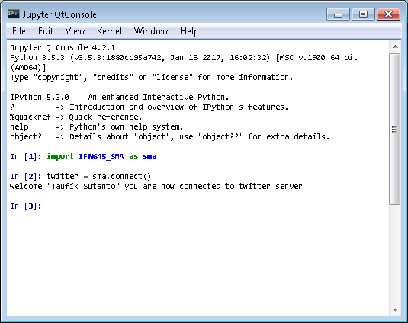
Social Media Crawling
Open/execute “IPython Qt Console.exe” from C:\WinPython\
From the prompt, execute the following command : import Sutanto_SMA as sma
Connect to twitter using the following command: twitter = sma.connect()
You should be prompted with welcoming message as in the screenshot. Otherwise please check your API keys.
Given no error message(s), we are now ready to start importing/crawling for social media data.

Slide 11

Social Media Crawling
There are multiple ways to import data from a social media such as twitter.
Searching using a query; Streaming; or importing from a user(s) timeline.
In this lecture we will do a twitter search on a topic of “data mining” using Twython module.
In the future you can change the topic suitng to your need.
Before we begin please review the twitter “Terms of Service” and “API limitations”:
https://twitter.com/tos?lang=en
https://dev.twitter.com/rest/public/rate-limiting

Slide 12
Crawling by Search
To search (crawl) for twitter data related to a topic, do the followings in the ipython terminal:
topic = ‘data science’
Tweets = sma.getTweets(twitter, topic)
Tweets is a list (array) of tweet data. You can look at the first tweet using the following command:
print(Tweets[0])
The second tweet can be accessed by changing the index from 0 to 1, and so on (i.e. print(Tweets[1]))
All tweets are in the format of a Python dictionary, hence we can access each element of a tweet using its “key”. For example the following commands will print the tweet’s username, date it’s created, and its tweet text:
tweet = Tweets[0]
print(‘Tweet by %s at %s, tweet: %s’ %(tweet[‘user’][‘screen_name’],tweet[‘created_at’],tweet[‘text’]))
The keys in the above example are : ‘user’, ’screen_name’, ‘created_at’, and ‘text’.

Slide 13
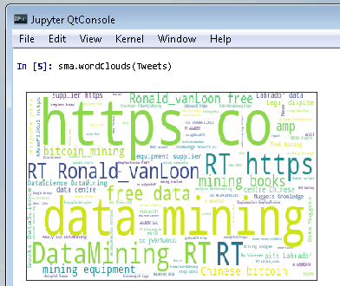
WordClouds
Another method to view the social media data is to create word clouds.
The word clouds can be generated using the following command:
sma.wordClouds(Tweets)
The size of the words corresponds to the frequency of the words in the Tweets data.
Notice that we have noises/stop words (e.g. https, RT, etc) in the twitter data.
Next, we will do pre-processing to remove these noises.

Slide 14
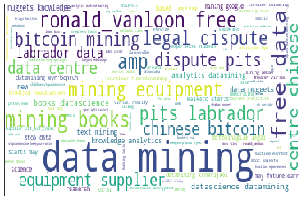
PreProcessing
In order to clean the twitter data, the parameter “clean” is set to True on the crawling function.
Tweets = sma.getTweets(twitter, topic, clean = True)
Generating word clouds from the new Tweets data will now result in a cleaner data as shown in the new word clouds.
sma.wordClouds(Tweets)
The preprocessed data can also be confirmed using the print command:
print(Tweets[0][‘text’])

Slide 15
Crawling & Word Clouds parameters
To modify the number of tweets crawled, a parameter N is provided.
The parameter lan is used to set the tweet language.
For example the following command will crawl 100 English pre-processed Tweets.
Tweets = sma.getTweets(twitter, topic, N = 100, lan = 'en', clean = True)
The number of tweets captured is bound to the twitter API rules explained here: https://dev.twitter.com/rest/public/rate-limiting
The language codes (e.g. en, id, es, etc) is explained here: https://dev.twitter.com/web/overview/languages
The generated wordcloud is automatically saved in C:\WinPython\notebooks\ as wordCloud.png.
The following command will change its default file name:
sma.wordClouds(Tweets, file = 'wordClouds_preProcessed.png')

Slide 16
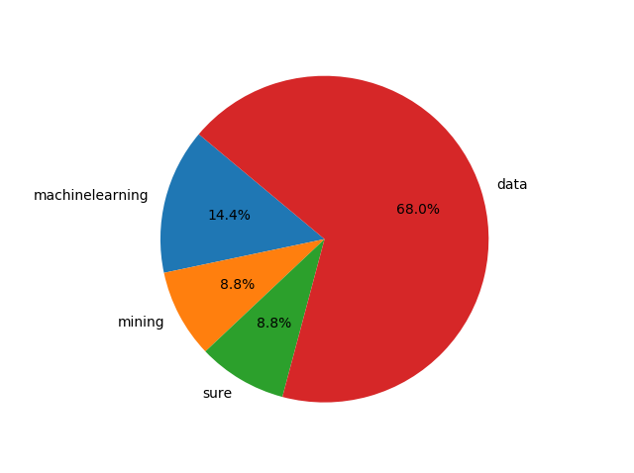
Tweet Topics
Another way to display the various information within a social media data is via a topic modelling such as Latent Dirichlet Allocation (LDA) [*].
To display the 10 most popular topics from our tweet data you can use the following command:
sma.getTopics(Tweets, topic=topic, tweetTopics=True)
Notes that the LDA is computationally expensive and require a significant amount of computer’s memory. Therefore only use this command if your Tweets is not large (~ <50,000). Otherwise, do a topic modelling on clusters/communities as we are going to discuss latter.
[*] http://www.cs.columbia.edu/~blei/papers/BleiNgJordan2003.pdf

Slide 17


Saving & Loading
For repeatability or other purposes, tweets can be saved using the following command:
sma.saveTweets(Tweets, file='Tweets.json')
To load the saved tweet data you can use the following command:
Tweets = sma.loadTweets(file='Tweets.json')

Slide 18
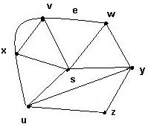
Graph
What is a graph G?
It is a pair G = (V, E), where
V = V(G) = set of vertices
E = E(G) = set of edges
Example:
V = {s, u, v, w, x, y, z}
E = {(x,s), (x,v)₁, (x,v)₂, (x,u), (v,w), (s,v), (s,u), (s,w), (s,y), (w,y), (u,y), (u,z),(y,z)}

Slide 19
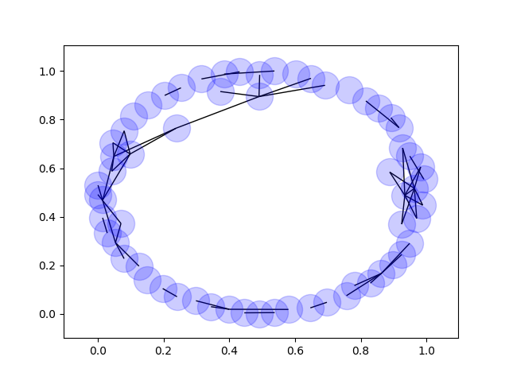
Social Network Graph in Python
The following command will build a social network graph based on users’ mentions.
G = sma.buildGraph(Tweets)
Each vertex corresponds to twitter screen_name and the edges of the graphs are mentions between users.
The following command will view/draw the graph.
sma. drawGraph(G)

Slide 20
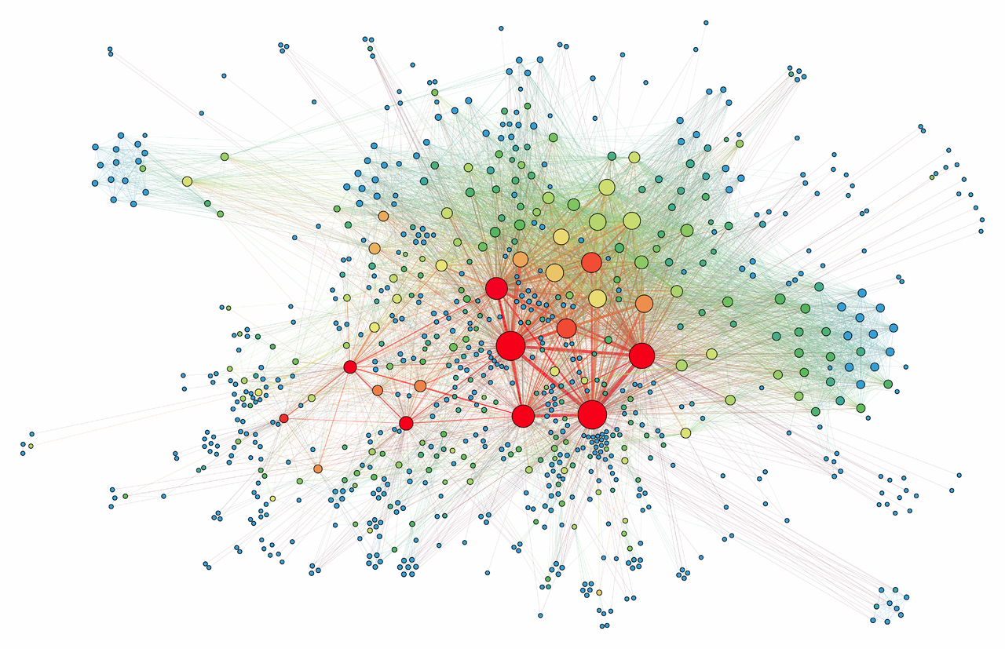
Centrality Analysis
centrality identify the most important vertices (Social media users) within a graph (Social Media Network Data).
We will use NetworkX module in Python to do the centrality analysis.
https://en.wikipedia.org/wiki/Centrality

Slide 21
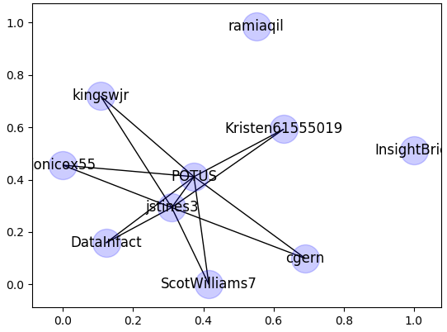
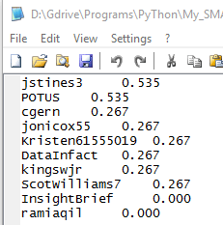
Centrality Analysis in Python
The following commands will find most important users based on ‘degree’.
Degree Method:
Gt = sma.centrality(G, Nimportant=10, method='degree')
sma.drawGraph(Gt, file =‘degree.png', labels=True)
The commands above also produce centrality details and saved as Centrality_details.txt in the Notebook’s folder.
Since edges in the graph G is based on mentions. Furthermore, a degree of a (user) node in a graph is the number of edges connected to that node. Users that are mentioned more frequently are the “important” users.
In what cases do you think we should consider edges by followers instead of mentions?

Slide 22
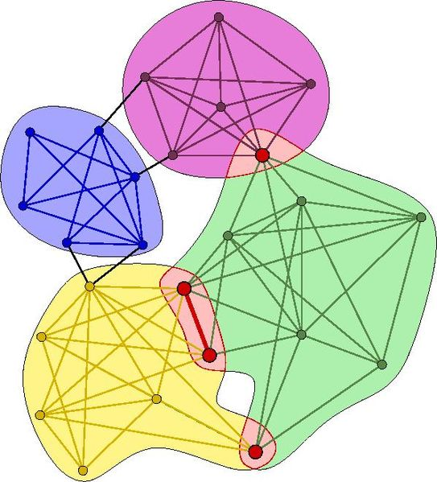
Community Detection
A network is said to have community structure if the nodes of the network can be easily grouped into sets of nodes such that each set of nodes is densely connected internally.
Networks with high modularity have dense connections between the nodes within modules but sparse connections between nodes in different modules.
https://commons.wikimedia.org/wiki/File:Illustration_of_overlapping_communities.jpg

Slide 23
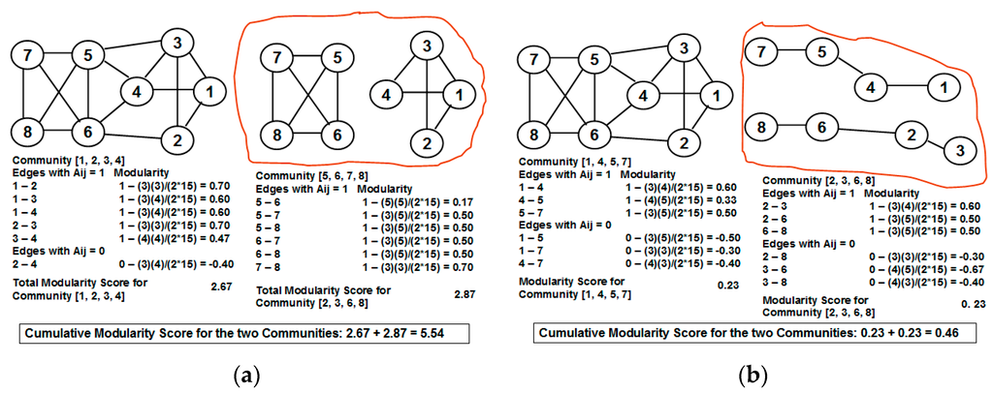
Community Evaluation using Modularity
Natarajan Meghanathan, A Greedy Algorithm for Neighborhood Overlap-Based Community Detection, Algorithms 2016, 9(1), 8; doi:10.3390/a9010008, http://www.mdpi.com/1999-4893/9/1/8/htm

Slide 24
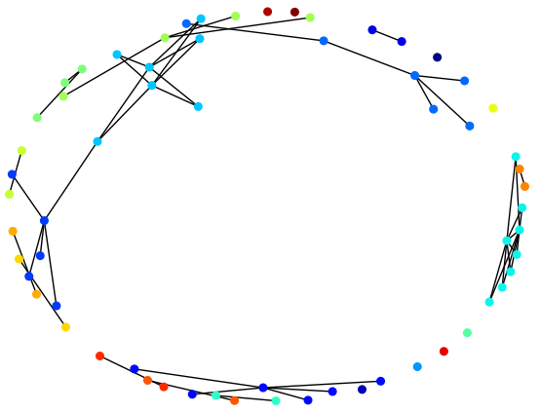
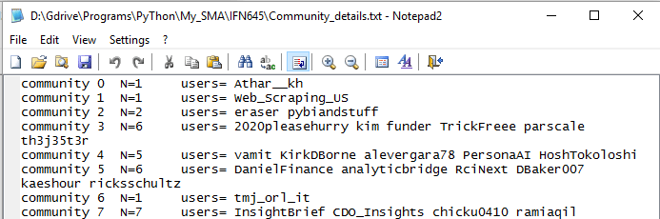
Community Analysis in Python
In Python we will use Thomas Aynaud’s Community (Louvain) module.
The following command will find the best partitions (communities) from a network graph G.
com = sma.communities(G)
A graph of the community will be drawn using different colors for each community.
The command will also produce centrality details and saved as Community_details.txt in the Notebook’s folder.

Slide 25
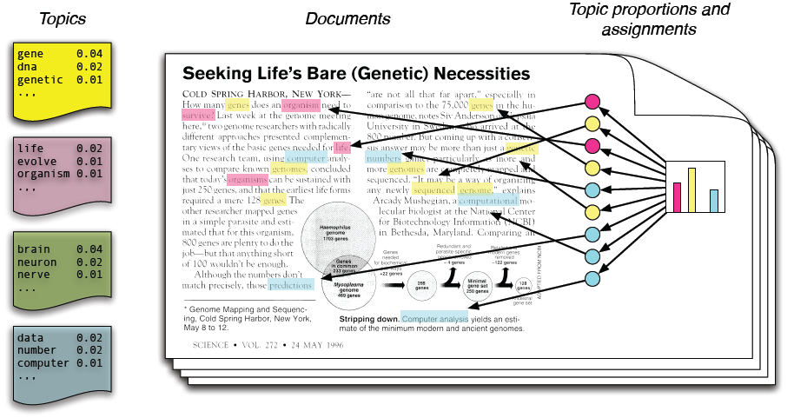
Topic Modelling : Latent Dirichlet allocation (LDA)
LDA is a generative statistical model that allows sets of observations to be explained by unobserved groups that explain why some parts of the data are similar. For example, if observations are words collected into documents, it posits that each document is a mixture of a small number of topics and that each word's creation is attributable to one of the document's topics.
Reference: http://www.cs.columbia.edu/~blei/papers/BleiNgJordan2003.pdf
https://rpubs.com/rain10241/63854

Slide 26
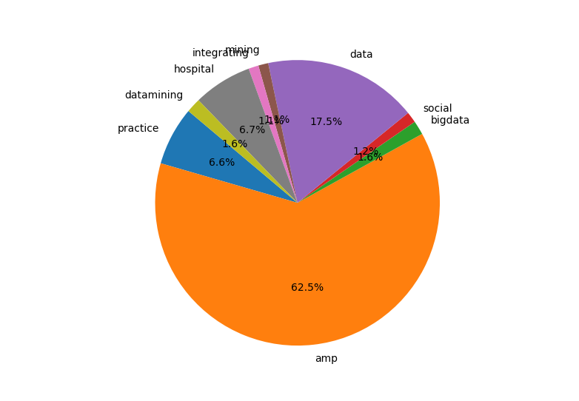
Topic Modelling (LDA) in Python
We will utilize LDA to summarize the topics within the community that we found before.
The following command from the IFN645_SMA module will create a pie chart of the first (largest) community (index = 0):
sma.getTopics(Tweets, com[0], topic=topic, nTopics = 10, file = 'Topics_1st.png')
Similarly to get the topics of the second largest community can be done in the following way (index = 1):
sma.getTopics(Tweets, com[1], topic=topic , nTopics = 10, file = 'Topics_2nd.png')
Notes that the LDA require a sufficient amount of data. It will fail to produce the topic models if the community is too small.

Slide 27
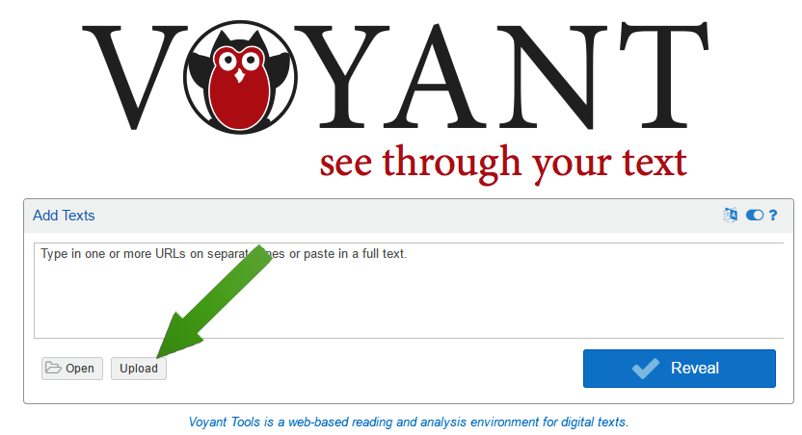
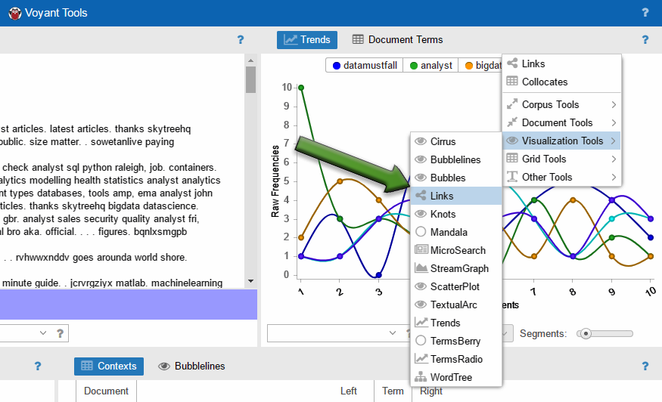
Concept/Word Links
We can create something similar to SAS EM concept/words links as in Week 10 practical.
Open https://voyant-tools.org/ on your browser.
Upload “Cluster_Text.txt” from your C:\WinPython\notebooks\ folder.
Choose Links Visualization from the top-right panel (see screenshots).

Slide 28
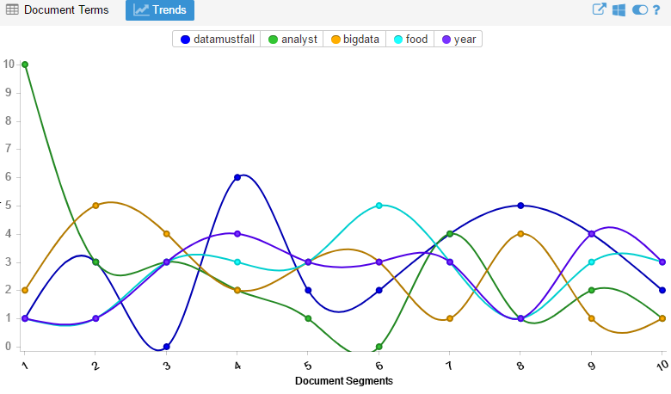
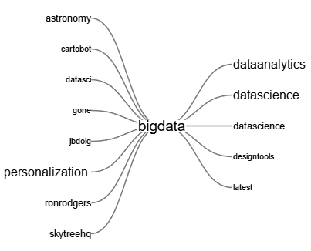
Word Links & Other Visualizations Explained
Notes:
Saving the visualizations : Export image

Slide 29
Save / Backups
Don’t forget to copy the WinPython folder to your own home drive or a flash drive for future use.

Slide 30
Reminder
twitter Terms of Service and API limitations
https://dev.twitter.com/overview/terms/agreement-and-policy
https://dev.twitter.com/rest/public/rate-limiting
API are divided into 15 minute intervals.
Search will be rate limited at 180 queries per 15 minute window.
Twitter Error Status for debugging: https://dev.twitter.com/overview/api/response-codes

Slide 31
Exercise
Go to www.twitter.com and find most trending topics in Indonesia.
Create a word clouds of the most popular topic from 1,000 tweets.
Determine 10 most important users from this most trending topic.
How many communities formed from this topic?
Interpret three largest communities.
Advanced Exercise:
Do a text clustering as explained in Week 10 using the Tweet data. Compare and analyse the text clustering results with the community detection. [**]
Choose a popular brand as the topic (e.g. “iphone”). Make some business recommendations based on your social media analysis. [***]
Modify the code to build a graph of followers instead of mentions. [*****]

Slide 32

Next week

